Slide 1

Spending Trend: Predicting Student Spending Pattern
By:
Korlapati Akhila
Vemulapally Keerthi
Naga Varshitha
Pakkala. Manisha

Slide 2
Presentation Outline
Introduction
Problem statement
Data set
Data Analysis and Exploration
Algorithm
Results
Conclusion

Slide 3
Introduction
In today's rapidly evolving economic landscape, where consumer behavior is pivotal in shaping market dynamics, understanding the spending patterns of distinct demographic groups has become increasingly essential.
Spending Trend is a predictive model aimed at forecasting the spending behavior of students based on various factors such as demographics, income, and lifestyle choices.
Leveraging machine learning algorithms, the model analyzes historical spending data to identify trends and patterns, enabling accurate predictions of future expenditures.
By incorporating features such as student age, gender, location, academic field, and income level, Spending Trend provides personalized insights into individual spending habits.
Spending Trend offers actionable budget management and financial planning recommendations based on predicted spending patterns.

Slide 4
Problem Statement
Despite the growing recognition of the importance of understanding and predicting student spending patterns, existing methodologies often fall short in providing accurate, granular insights that can inform effective financial management strategies. However, several key challenges must be addressed to realize the full potential of Spending Trend. Spending Trend aims to revolutionize our approach to understanding and managing student spending patterns, paving the way for more informed decision-making, enhanced financial literacy, and improved academic outcomes for students worldwide.

Slide 5
Data set
Dataset Acquisition To acquire the dataset for the Spending Trend project, we need to gather relevant data on various demographic, financial, and spending-related variables from a diverse sample of students. Here's a proposed approach for acquiring each type of data:
1. Demographic Data (age, gender, year in school, major)
2. Financial Data (monthly income, financial aid)
3. Spending Data (tuition, housing, food, transportation, books & supplies, entertainment, personal care, technology, health & wellness, miscellaneous)
4. Preferred Payment Method Data
Features of the Dataset
Age, Gender, Year in school, Major, Monthly income, Financial aid, Tuition, Housing, Food, Books and Supplies, Entertainment, Personal care, Technology, Health & Wellness, Miscellaneous, Payment method.

Slide 6
Data Analysis and Exploration
Data Cleaning
Descriptive Statistics
Data Visualization
Feature Engineering
Correlation Analysis
Outlier Detection
Segmentation Analysis
Predictive Modeling
Insights and Recommendations

Slide 7
Algorithm
Multinomial Regression
Predicting Spending Categories
Identifying Factors Influencing Spending Categories
Understanding Spending Behavior
Model Evaluation and Comparison
Personalized Recommendation
Naïve Bayesian Algorithm
Classification of Spending Behavior
Prediction of Spending Preferences
Identification of Influential Factors
Personalized Spending Recommendations
Fraud Detection

Slide 8
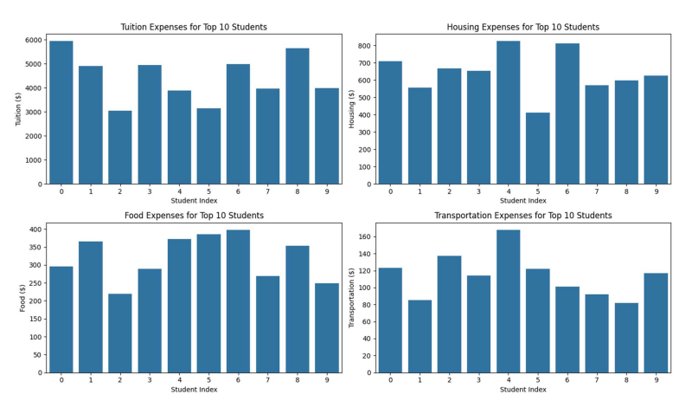
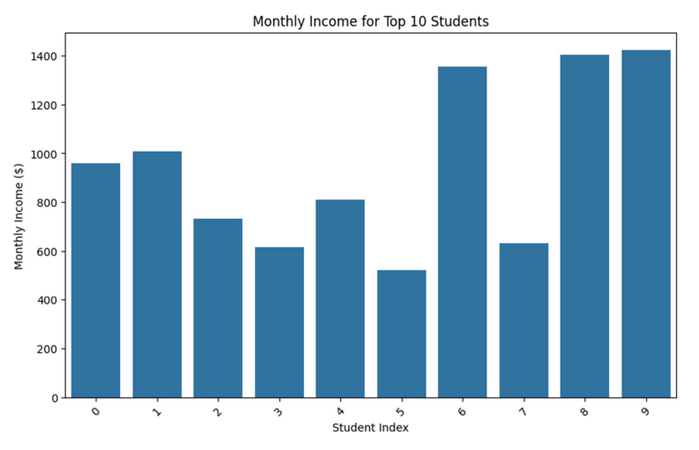
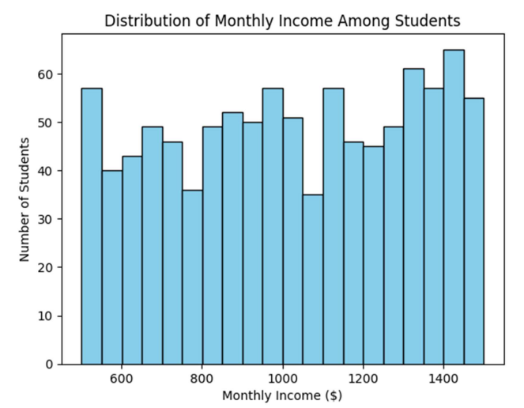
Results
The results are shown in the form of graphs for better understanding.

Slide 9
Conclusion
The development of the Student Spending Prediction Model represents a significant advancement in our ability to understand, anticipate, and manage student spending patterns effectively.
Through a comprehensive data analysis and exploration process, coupled with advanced machine learning techniques, the model offers valuable insights and predictive capabilities that can empower stakeholders to make informed decisions and promote financial well-being among students.
By leveraging a diverse set of features such as age, gender, major, income level, and expenditure categories, the model accurately captures the complex dynamics of student spending behavior.
By harnessing the power of data and predictive analytics, the model equips stakeholders with the insights and resources needed to navigate the complexities of student finances effectively, ultimately contributing to a more financially literate and resilient student population.

Slide 10
Thank You
Questions?

